Slide 1


Amazon Reviews Star-rating Prediction and Topic Modeling
Suzanne Zhen

Slide 2
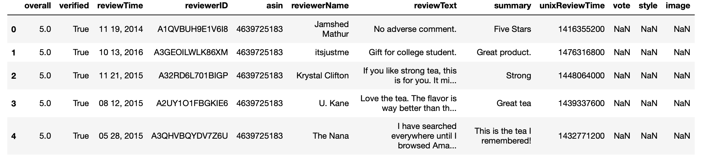
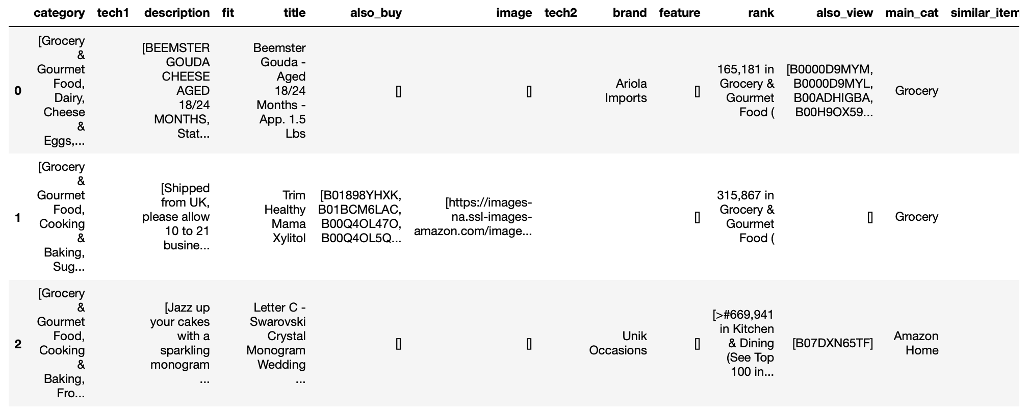
Dataset
Amazon Review Data published by UCSD
A subset of the data (Grocery and Gourmet Food) will be used for this project
1.1 million reviews, 41k products, 26 subcategories
from 2000 to 2018 (remove reviews before 2013 since irrelevant)

Slide 3
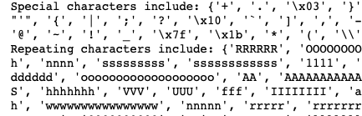
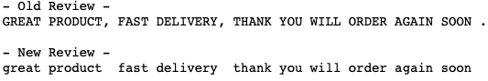
Data Cleaning
Round 1:
Lowercase
Remove special characters, numbers, repeating characters
55% reduction in vocabulary size (98k words remained)
Round 2
Lemmatization with POS tagging (transform to root words)
Stop words removal (“the”, “can”, “be”, “not”)
Lemmatization
tasted
tasting
taste
boxes
box
taste
box

Slide 4
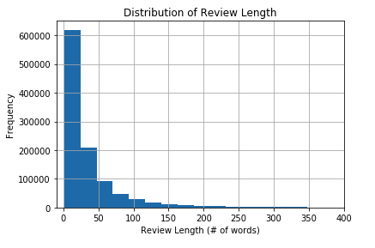
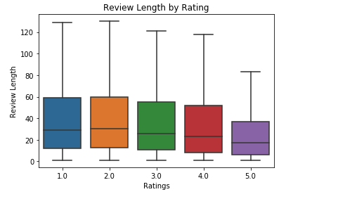
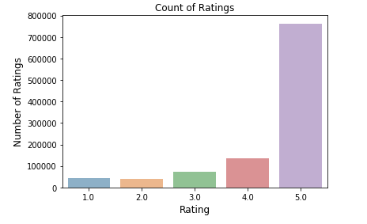
Exploratory Data Analysis
Words and Ratings Distribution
Average word count per review is 35
Majority of the reviews under 50 words
Lower rating reviews are longer compared to high rating reviews
Rating distribution is highly imbalanced
5– 72%
4 -13%
3 - 7%
2 – 4%
1 – 4%
Under-sampled to 10k reviews (evenly distributed ratings, 80% training and 20% testing)
28k unique words

Slide 5
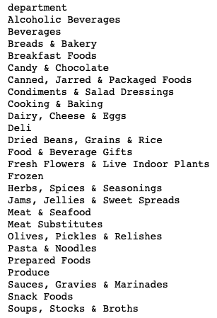
Exploratory Data Analysis
Categories with lower ratings at 25 percentile
(3): Alcoholic Beverages, Prepared Foods
(4): Breads & Bakery, Candy & Chocolate, Dairy, Cheese & Eggs, Fresh Flowers & Live Indoor Plants, Pasta & Noodles, Sauces, Soups, Snack Foods, Produce

Slide 6
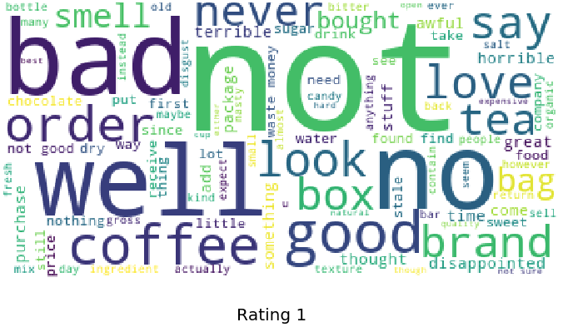
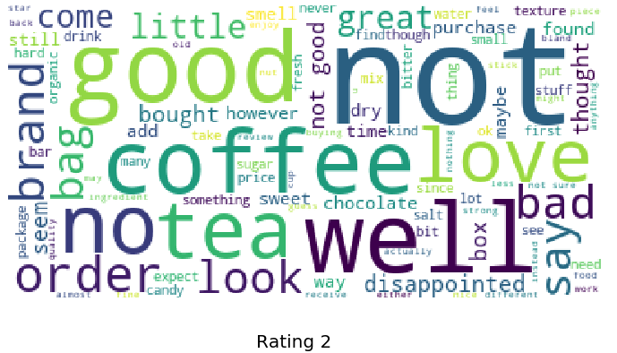
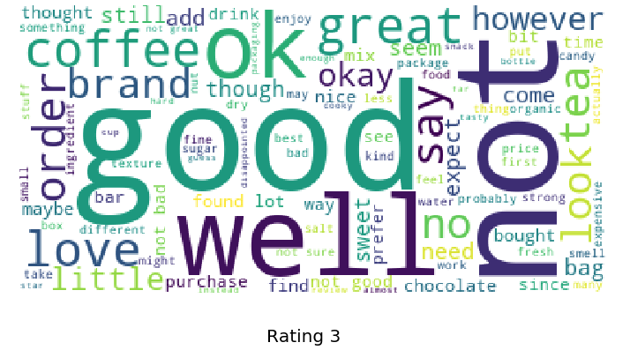
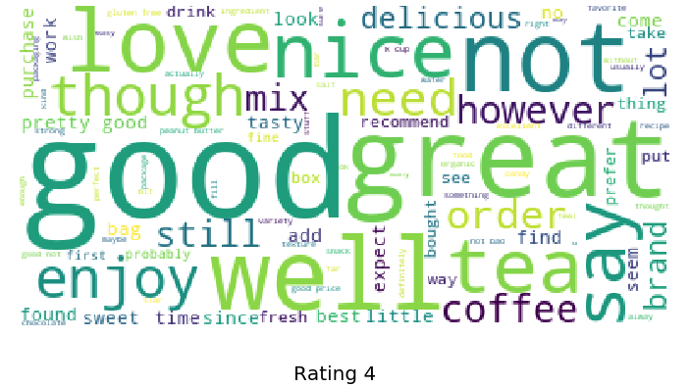
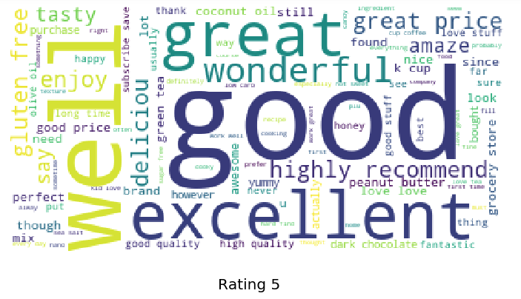
Word Cloud by Rating

Slide 7
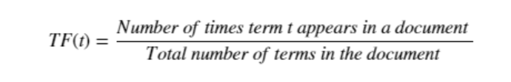
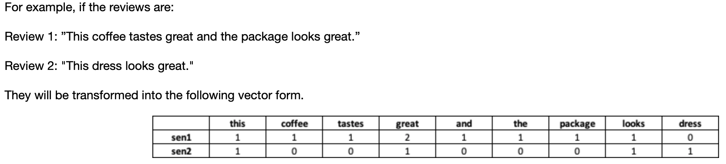
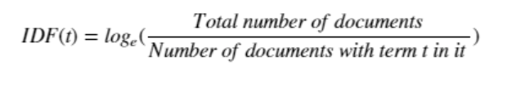
Word Vector Transformation
Term Frequency-Inverse Document Frequency (TFIDF)
Statistical evaluation of how important a word is to a document in a corpus
Two parts: Term Frequency (TF) and Inverse Document frequency (IDF)
TF: measures the frequency of the word in current document
IDF: measures the rarity of the word across documents
TFIDF = TF*IDF
1, 2 gram, use the top 3000 words with highest weights
Bag of Words (BOW)
A vocabulary of known words (each word is a gram)
Frequency of known words
Creates word vectors and a sparse matrix of documents
use the top 3000 words with highest frequency
Drawbacks
missing information about word positions in the text, semantics, and co-occurrences with other words
If vocabulary size is large, matrix is very sparse, curse of dimensionality
Notes:
extracting features from text for use in modeling
For example:
Review 1: ”This coffee tastes great and the package looks great.” Review 2: "This dress looks great."
The word "great" appeared twice in the document with total of 9 words. Therefore, the term frequency for "great" is 2/9 while the term frequency for all other words are 1/9.
IDF("great") = log(2/2) = log(1) = 0, IDF("coffee") = log(1/2) = -0.3

Slide 8
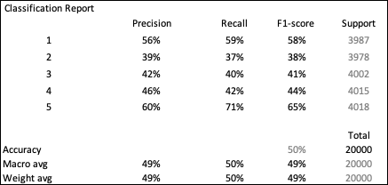
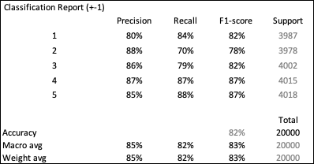
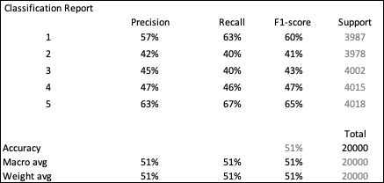
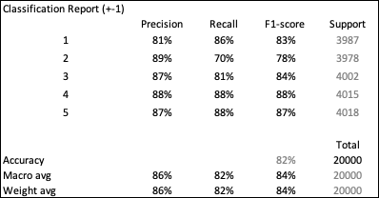
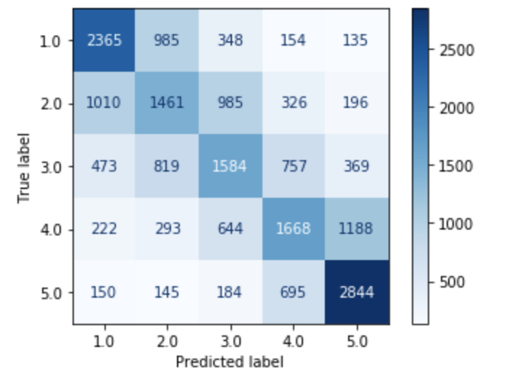
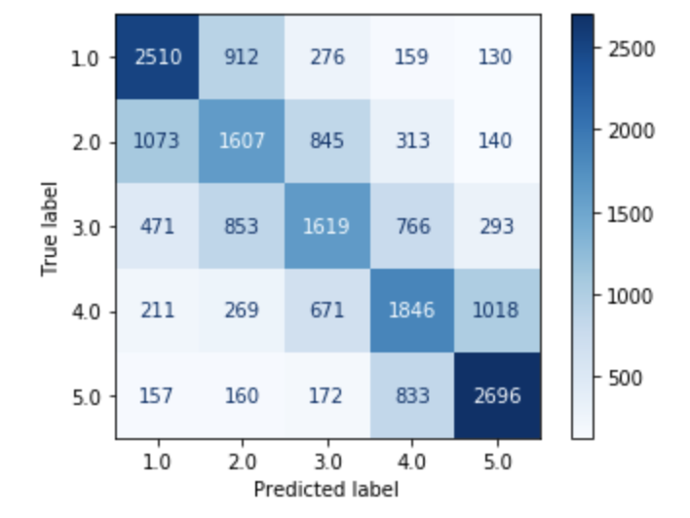
Modeling with Multinomial Naïve Bayes
BOW with MNB:
Confusion Matrix:
TFIDF with MNB:
Confusion Matrix:

Slide 9
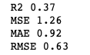
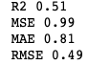
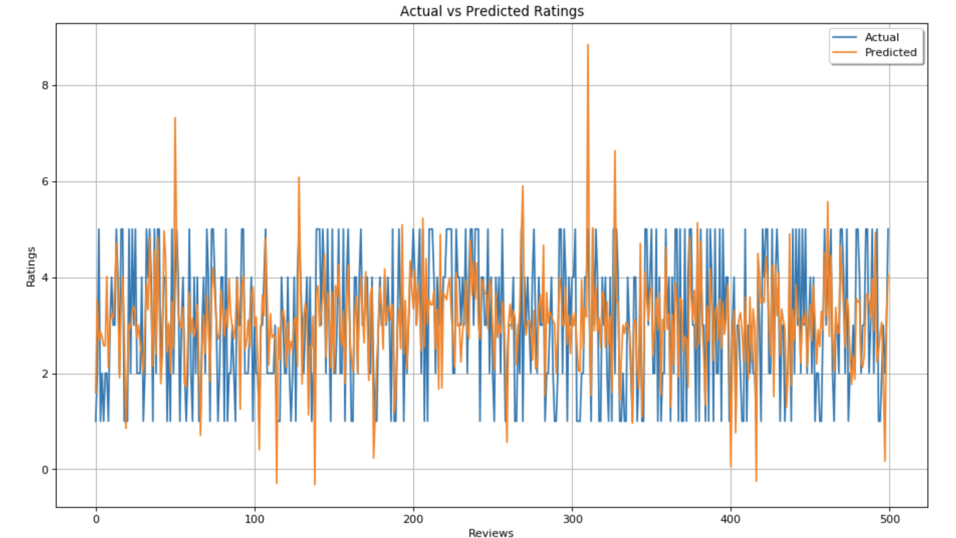
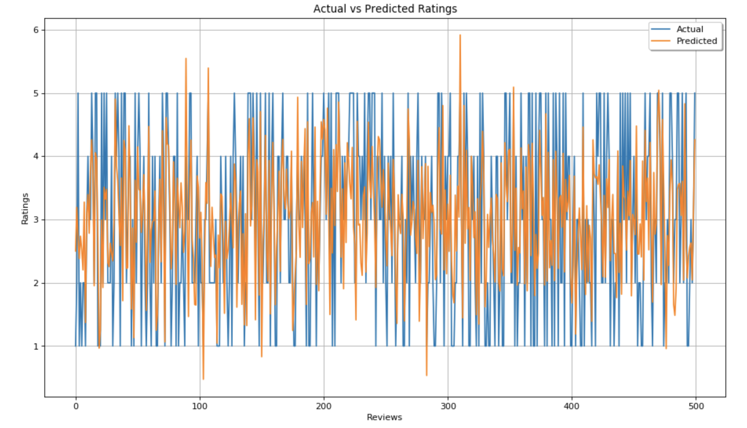
Modeling with SGD Regressor
BOW with Regression
First 500 points of y_predicted vs y_actual:
TFIDF with Regression:
First 500 points of y_predicted vs y_actual:

Slide 10
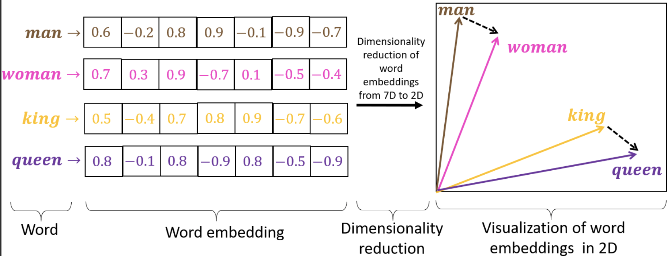
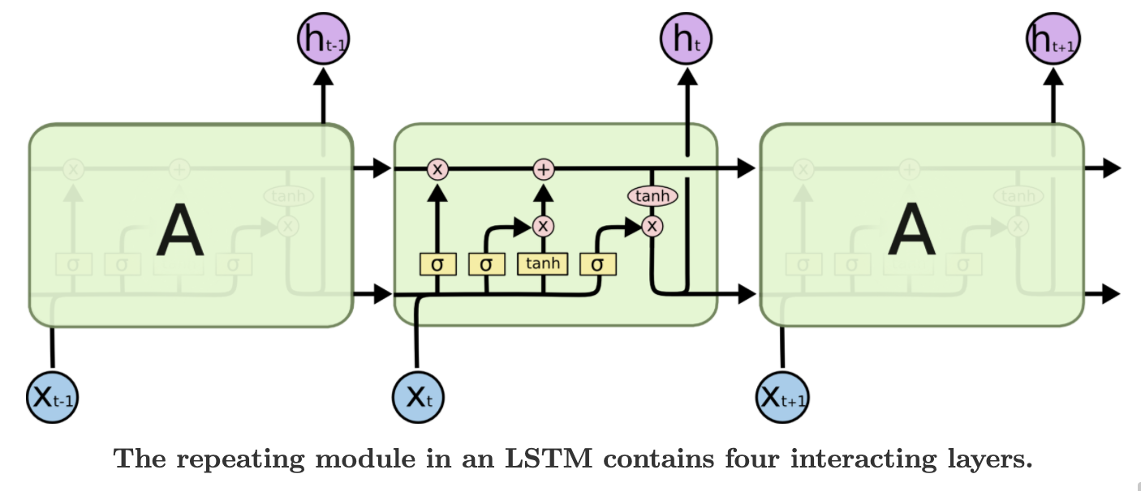
GloVe Word Embedding with LSTM
Word Embeddings
Individual words are represented as vectors with defined dimensions (feature space) instead of a single number
Relationship between words is captured by the cosine similarity between word vectors
GloVe Model: developed by measuring the co-occurrence probabilities between words in a given corpus
Pre-trained embedding based on Twitter messages (100 dimensions), 1 million word vectors
LSTM
Recurrent neural network
Stores information in long term memory
Learn ordering of sequence and context when making predictions
Model: 100 units, 0.2 dropout, 80 epochs
Notes:
https://journals.plos.org/plosone/article?id=10.1371/journal.pone.0231189#pone-0231189-g008
http://colah.github.io/posts/2015-08-Understanding-LSTMs/
Glove embedding – uses matrix factorization to decompose large matrices

Slide 11
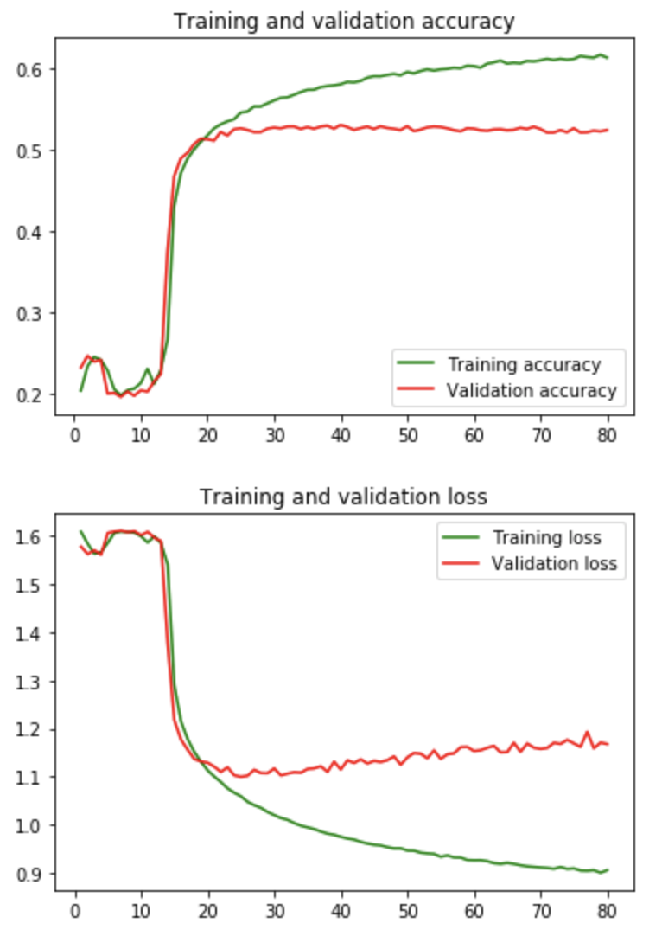
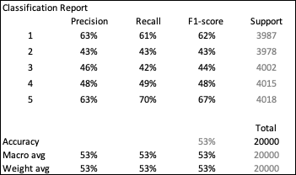
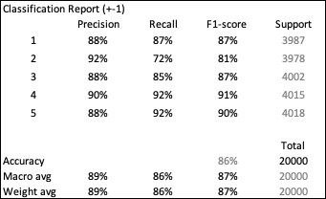
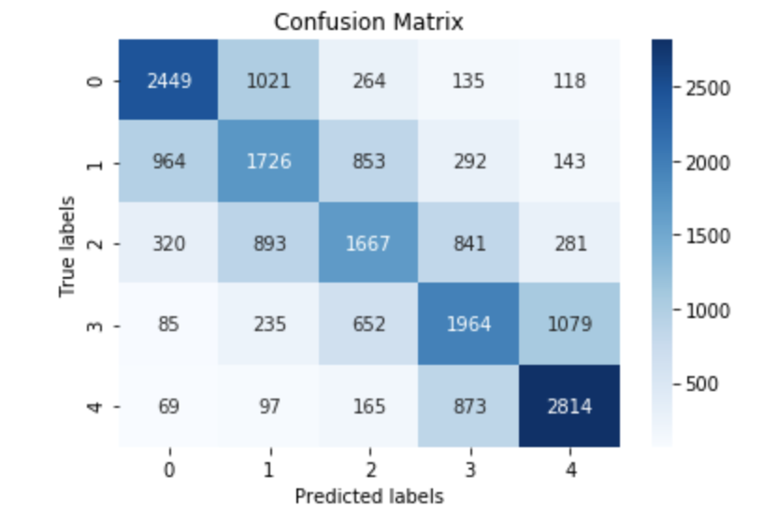
GloVe with LSTM Results

Slide 12
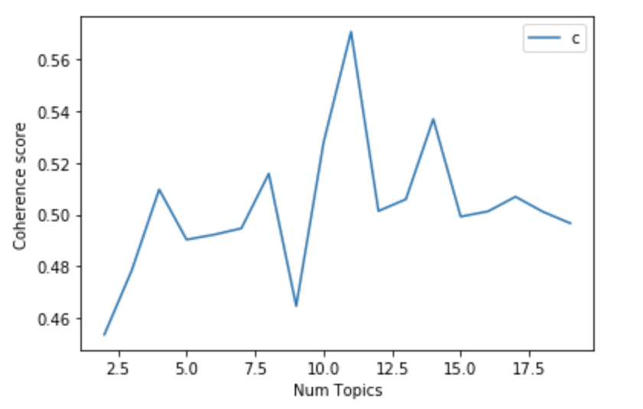
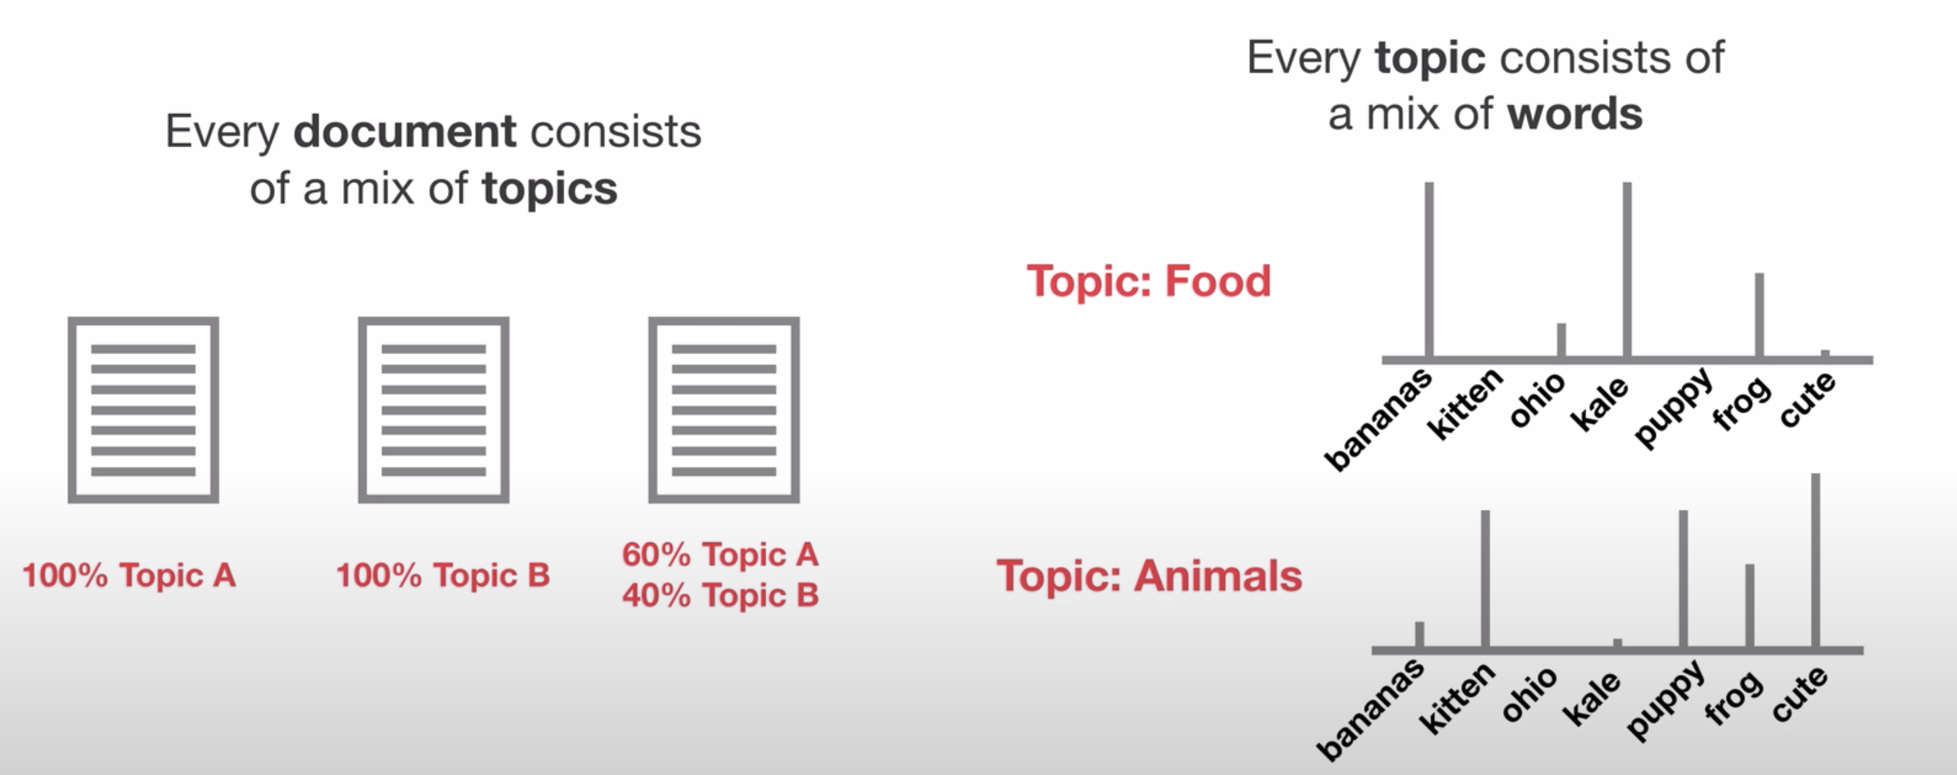
LDA Topic Modeling
Latent Dirichlet Allocation (LDA)
Topic Modeling: unsupervised learning
Represent a text document with several topics through word clustering
Find the underlying distribution of topics within documents and distribution of words within topics
Evaluation metric: perplexity and coherence score
Perplexity: statistical measure of how well the model predicts new samples (the lower the better)
Coherence Score: measures the semantic similarity between high scoring words
Finding the optimal number of topics by coherence score
Notes:
https://medium.com/analytics-vidhya/topic-modeling-using-lda-and-gibbs-sampling-explained-49d49b3d1045
Latent = find the hidden topics in text
Dirichlet = probability distribution

Slide 13
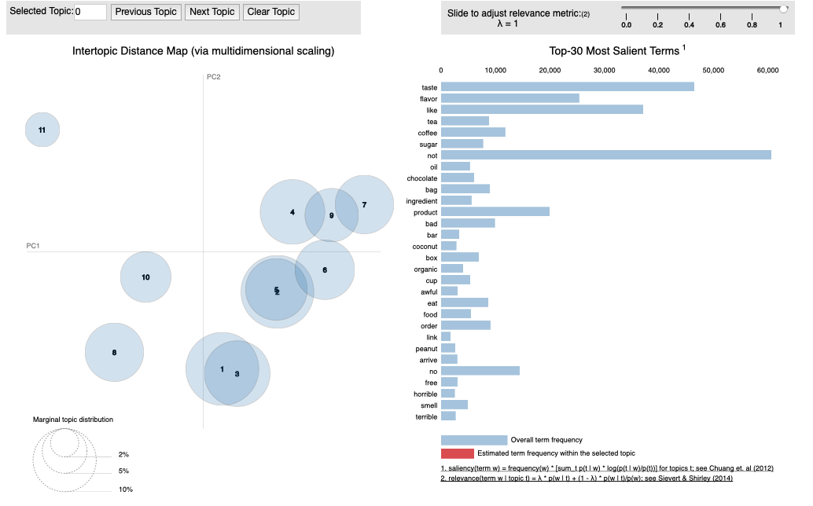
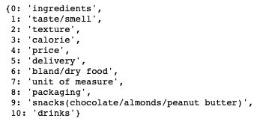
LDA Results
List of topics

Slide 14
Thank You

